Slide 1
Section 3
2022-01-28

Slide 2
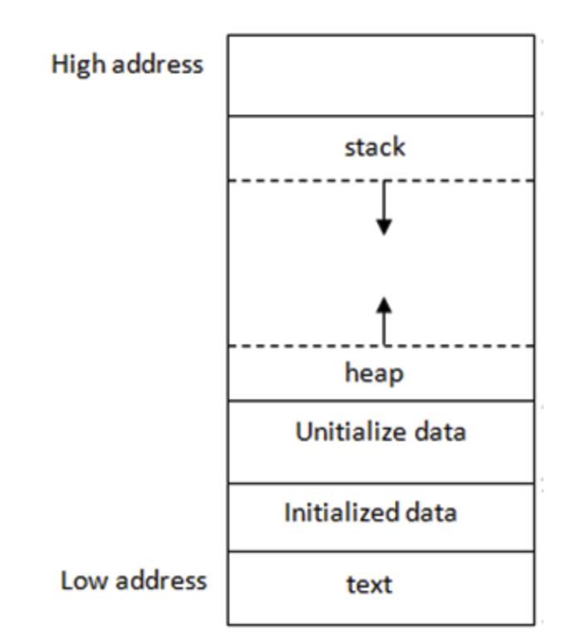
Memory layout and scope
Memory can be allocated in 2 places
Stack
Heap
Stack
Automatically allocated and deallocated using stack frames
All local variables are allocated on the stack
As soon as their code block ends, accessing them is undefined
Heap
Stores dynamically allocated data (i.e., when you use malloc/calloc)
Only freed when you call free
We don’t need them this week, so we will come back to these next time
Below the heap - reserved memory, static data etc.
Light extra reading: https://courses.engr.illinois.edu/cs225/sp2022/resources/stack-heap/

Slide 3
What is a code block?
Anything enclosed by {}
Hence:
Local variables declared locally in one function will not be available once that function ends
Local variables declared in if statements will not be available once the if statement ends
Local variables created inside any set of curly braces will not be available once the closing } is reached

Slide 4
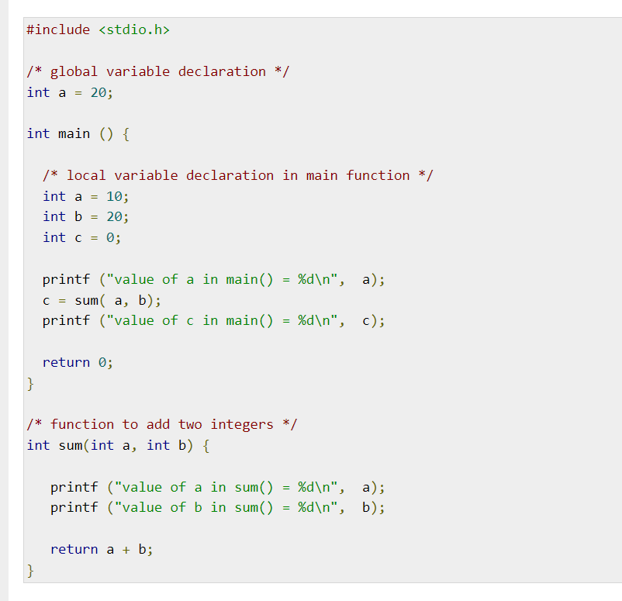
Source: https://www.tutorialspoint.com/cprogramming/c_scope_rules.htm

Slide 5
What is a pointer?
It’s just a variable that holds a memory address
We can try and read the memory address it points at by using the dereference operator, *
We can get a pointer to a variable by using the reference operator, &

Slide 6
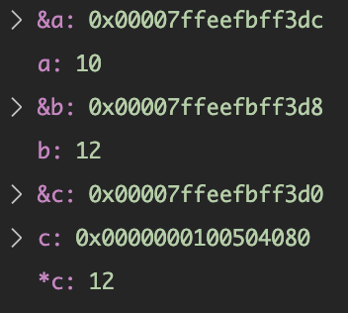

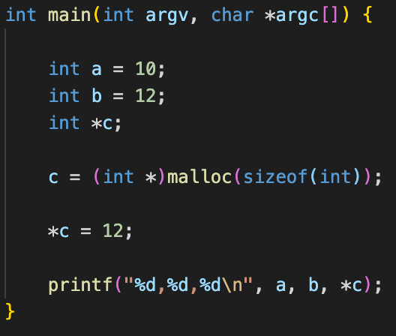


Memory address
Higher addresses
Stack
10
0x00007ffeefbff3dc
12
0x00007ffeefbff3d8
0x0000000100504080
NULL/Uninitialised
0x00007ffeefbff3d0
???
12
0x0000000100504080
Heap
0
OS and other reserved memory

Slide 7
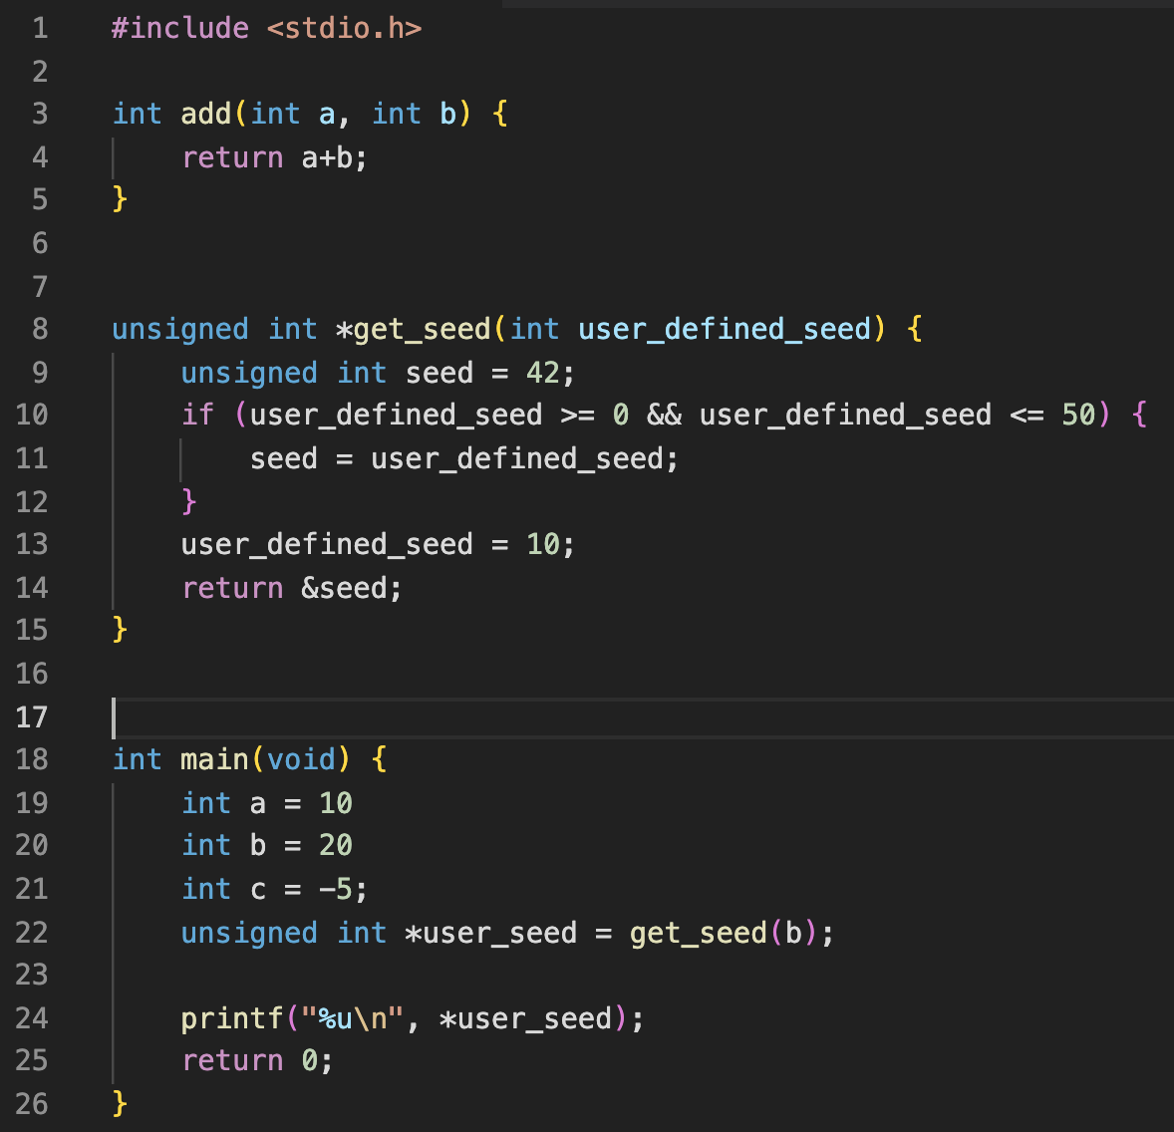
Stack

Slide 8
Stack
main:a
10

Slide 9
Stack
main:a
10
main:b
20

Slide 10
Stack
main:a
10
main:b
20
main:c
-5

Slide 11
Stack
main:a
10
main:b
20
main:c
-5
main:user_seed
??

Slide 12
Stack
main:a
10
main:b
20
main:c
-5
main:user_seed
??
get_seed:user_defined_seed
20

Slide 13
Stack
main:a
10
main:b
20
main:c
-5
main:user_seed
??
get_seed:user_defined_seed
20
get_seed:seed
42

Slide 14
Stack
main:a
10
main:b
20
main:c
-5
main:user_seed
??
get_seed:user_defined_seed
20
get_seed:seed
42

Slide 15
Stack
main:a
10
main:b
20
main:c
-5
main:user_seed
??
get_seed:user_defined_seed
20
get_seed:seed
20

Slide 16
Stack
main:a
10
main:b
20
main:c
-5
main:user_seed
??
get_seed:user_defined_seed
10
get_seed:seed
20

Slide 17
Stack
main:a
10
main:b
20
main:c
-5
main:user_seed
??
get_seed:user_defined_seed
10
get_seed:seed
20

Slide 18
Stack
main:a
10
main:b
20
main:c
-5
main:user_seed
??
get_seed:user_defined_seed
10
get_seed:seed
20

Slide 19
Stack
main:a
10
main:b
20
main:c
-5
main:user_seed
PTR

Slide 20
Stack
main:a
10
main:b
20
main:c
-5
main:user_seed
PTR
?????
??

Slide 21
Stack
main:a
10
main:b
20
main:c
-5
main:user_seed
PTR

Slide 22
What happens when we have an invalid pointer
We will only see weird effects when it is dereferenced (*invalid_ptr)
What can happen?
Segmentation fault
Can debug with lldb - Not enough time to cover it today
Happens when we access restricted addresses, such as 0 i.e. NULL
Compiler warning/error (if we’re lucky!)
Normally one of:
Unused variable warning
Undefined variable error
Stack address warning
Weird behaviour
Most common
You’ll notice that sometimes your program works, sometimes it crashes, and sometimes it gives unexpected results
Can use valgrind to find these

Slide 23
Arrays
int arr[7] = {0}
arr is just a pointer!
Accessing / setting variables can be done via arr[idx]
[] Is just an acronym for a pointer operation!
arr[3] == *(arr + sizeof(int) * 3)
Generalising:
Given definition: type arr[SIZE]
arr[idx] == *(arr + sizeof(type) * idx)
Therefore, arrays will not tell you if you are out of bounds - effects are same as using an invalid pointer!
We cannot use conventions from python such as slicing, negative indexes to index from the back and other tricks
If our array was declared with size 7, we can only use indexes 0,1,2,3,4,5,6 to get a valid result

Slide 24
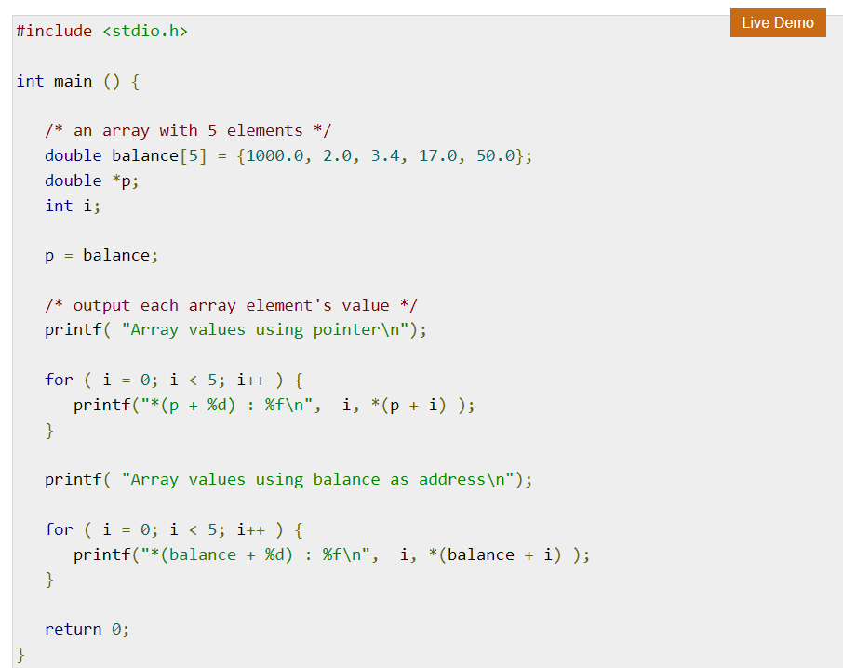
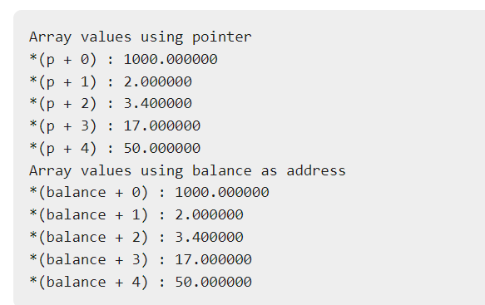
Output
Source: https://www.tutorialspoint.com/cprogramming/c_pointer_to_an_array.htm

Slide 25
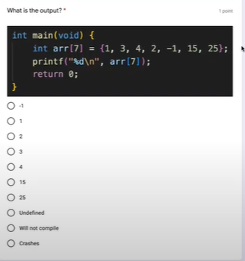

Slide 26
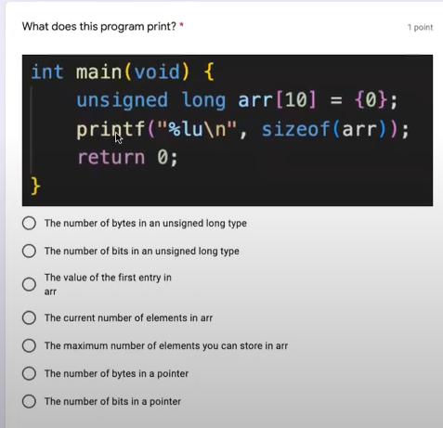

Slide 27
Summary
Pointers are EXTREMELY important
We’re imperfect - Everyone will access an undefined pointer at least once in their lifetime
How to save yourself pain:
Set invalid pointers to NULL
If you notice your program sometimes works and sometimes doesn’t, check for invalid pointer accesses - The issue might be a lot further up the program than it actually manifests
Reach out to tutors, the professor or TAs if you do not understand pointers
We are here to help!

Slide 28
Hwk 2
Setup
git clone git@git.ucsc.edu:ajrudnic/cse-13s-resources-winter-2022.git
Or if you have it cloned already, you can use: git pull to get the latest version
Copy across hwk2 files to your hw2 directory
You need to implement the functions in num_arrays.c

Slide 29
Understanding hwk2 file - You don’t need to change it!
Lines 7 - 22 read in the file “input.txt” - one number per line
Lines 24 - 42 then try to call your functions
You can change input.txt to contain different numbers so you can test your code!

Slide 30
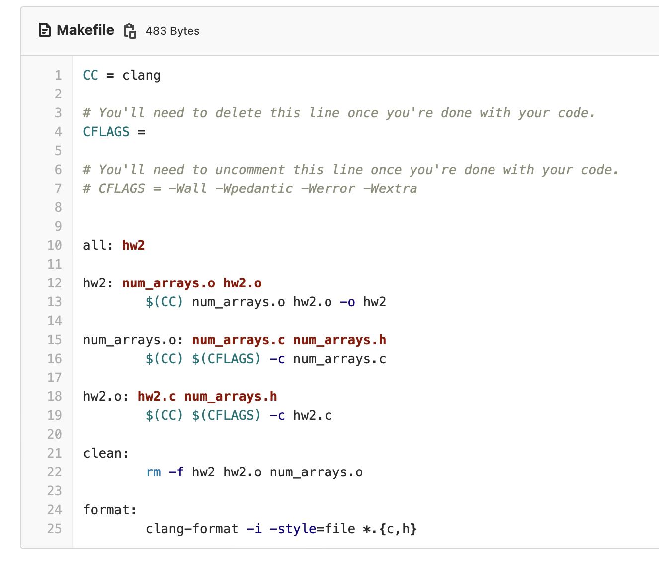
Makefile
Read the instructions in it!
Ensure it complies with the extra flags before submitting

Slide 31
What is reduce?
Combines all of the elements in an array with a specified function, cumulatively
You might have noticed that the shape of your previous two functions had a similar shape
Look at each element of the numerical array in turn and update a running value
Decoding the type:
int reduce(int *nums, int len,int (*f)(int,int), int initial)
Will return an integer
What is nums?
It is a pointer, but looking at the name of a variable, what is it pointing to?
How can we call the helper function we passed in?
What is initial?

Slide 32
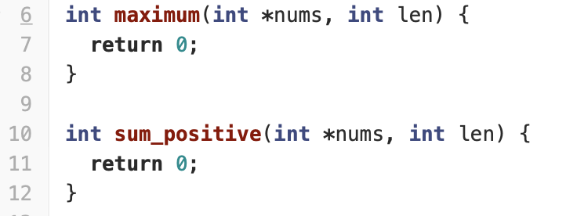
Basic functions
maximum
Given an array of ints, find the maximum value in the array
Why is len needed?
Make sure to return the maximum value, not 0!
sum_positive
Should return the sum of all positive elements of array nums

Slide 33
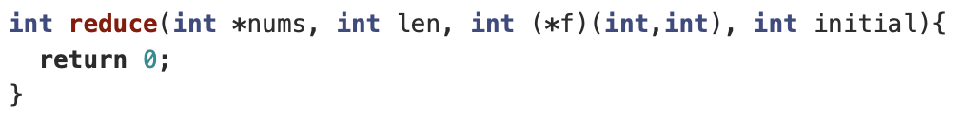
Reduce
Can you see a similar pattern in how you coded the 2 basic functions?
Lets try to abstract it out!
Lets assume we have a magic function ‘f’, that does the element-wise specific operation
How can we use it to create a skeleton for all similar operations?

Slide 34
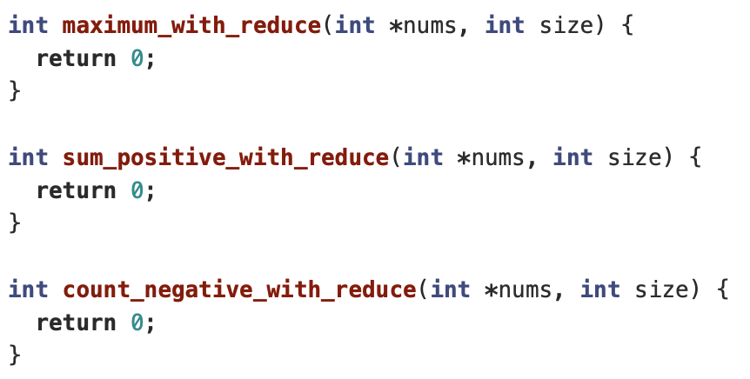
Using reduce
All of the following functions should use reduce
Each one needs a different helper function - you need to define these
You can define them at the top of this file
What should the initial value be for reduce?
Will it be different for some of these operations
(You may need limits.h to set a reasonable initial value for one of these functions)
You should be able to implement all of these functions in one line using a call to reduce!

